Slide 1

ASign
By: Mina Nashed

Slide 2
What Does ASign Do?
ASign is a basic homework management application!
The three core features that are planned or completed for are..
Allows you manage and schedule your own school work
Allows you to manage and schedule group projects/assignments
Creates project chat groups to coordinate with your team.

Slide 3
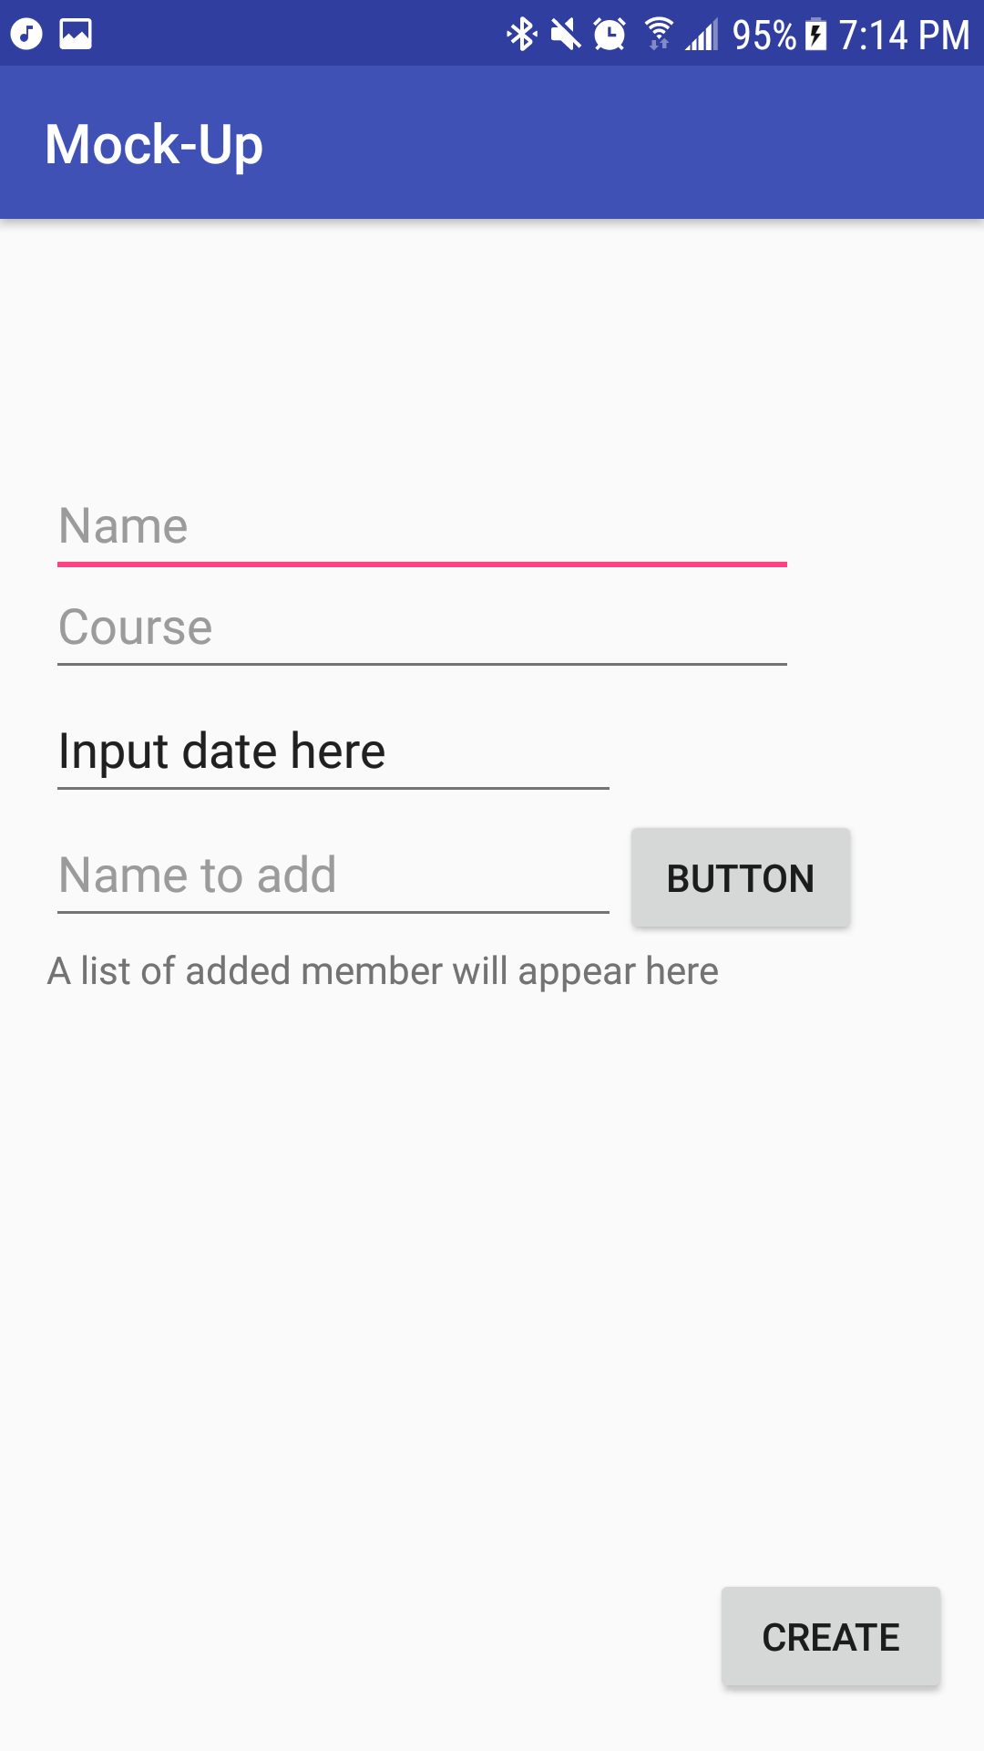
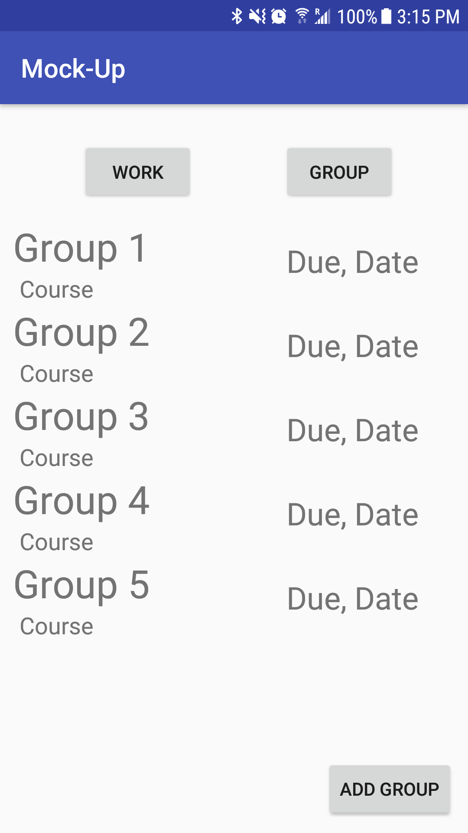
User Story!
Jimmy and his group project to create an app!

Slide 4
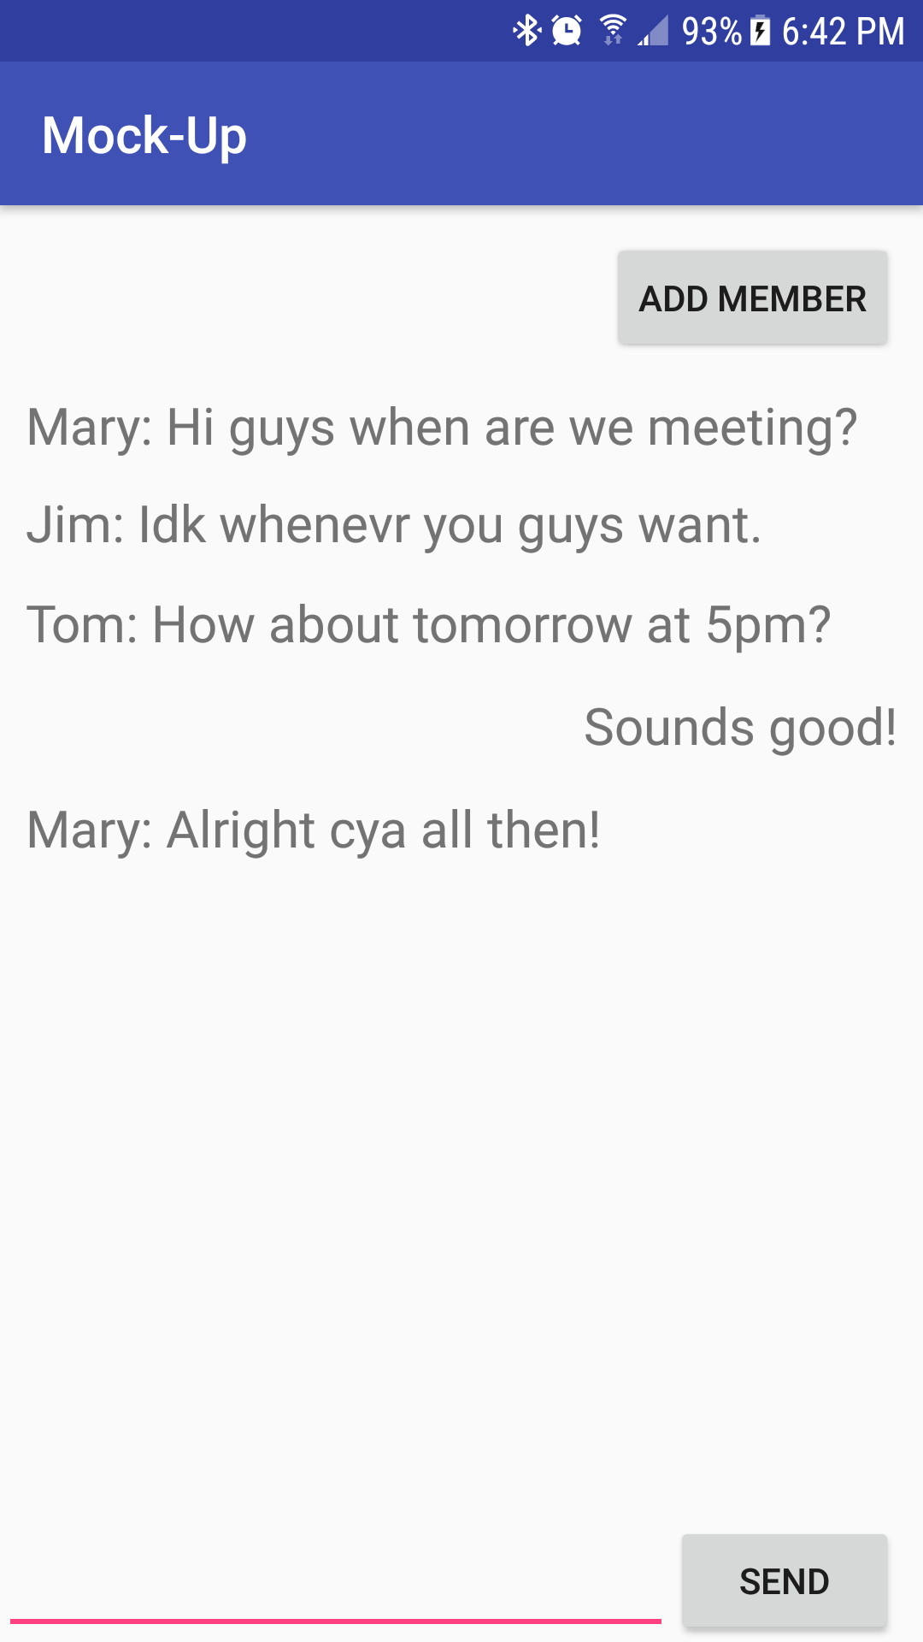
Jimmy now has all his group members in one place!
Makes jimmies life so easy since he doesn’t have to constantly flip through messaging applications to coordinate with different groups!
Not only does he have all his groups together but he has his personal homework one place as well!

Slide 5
Communicating With A Database!
Converting to and from a hosted database using PHP
Sending and retrieving information from JSON objects!

